Slide 1
Sustainable Fish Farming with Remote Water body Monitoring & Corrective Actions : Powered by IoT, Mobility & Analytics
Idea ID: 3439
Theme: Climate Change
Team Name: Pirates

Slide 2

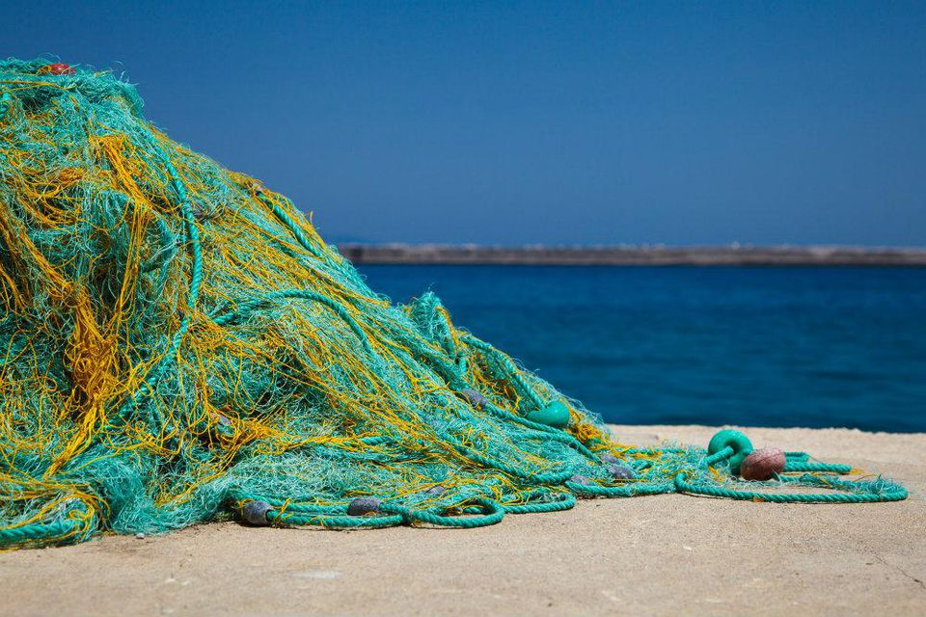

Climate Change is Here : Affecting Millions of Fishermen…
Climate Change Is Cutting Into the Global Fish Catch, and It's on Pace to Get Worse in the coming Years…
Global Fisheries Will Lose $10B A Year To Climate Change By 2050
A Forbes study conducted in 2018 indicates a potential decline of ~10% global fishing revenue within 3 decades if global warming is not contained
~30% dip in Fish Production due to Environmental Changes in Tropical Belt
A UN report published in Sep,2019 shows that inland and marine fishing in tropical region is poised to lose ~30% Fish production due to environmental changes
~87% of Developing Countries are Vulnerable to Climate Change related impact on Fisheries
A research conducted in 2017 shows that Fisheries in 87% of Developing Asian countries to be negatively impacted by climate change coupled with limited access to tools & technology
Global Warming Induced Threat on Fishing: Water Temperature | Salinity & Acidification | Sea Level Rise | Altered Nutrients

Slide 3
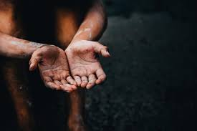

Call to Action : Empowering Fishermen with Digitization
The idea is to Leverage IoT, Analytics & Mobility in Empowering The Fishing Community for Sustainable In-land Fish Farming
…Remote Monitoring
…24x7 Feeds in Mobile
Raspberry Pi controlled IoT sensors installed over waterbody to remotely track water params (Temp, Oxygen level etc.)
Real-time feeds/notifications to users in Mobile Apps, orchestrated by IBM Cloud services, to notify water params and risk levels
SOLUTION
…Automated Corrective Actions
APPROACH
…Predictive Insights
Automated inputs to end-users on Corrective Actions for High Risk zones. Ability to integrate with Water Quality Management Systems for Zero-Touch Water Quality Correction
Potential of leveraging Machine Learning techniques for offering Predictive Insights on fish reproduction, stress level, fishing yield etc.
4 KEY PILLARS OF THE PROPOSED SOLUTION OFFERING:
Micro-Processor Controlled IoT Enabled Sensors | Database & App Services Hosted in IBM Cloud | Mobile App | Web-based Reporting Engine

Slide 4









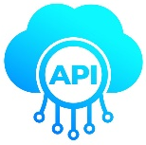


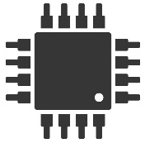

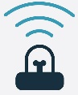




Solution Architecture : Aligning to Cutting-Edge Technology
End-Users (Fishing Community)
Web-App for Device Administration & Reporting
TECH STACK
Offers Admin Controls & Access Management
Detailed Reporting
Community Support
IoT Devices:
Alerts & Notification SMSs
SMS Server
Native Mobile App for Water Tracking & Monitoring
Micro-services:
*
AI Engine
Cloud hosted PaaS Database
Database:
Real-time Water Param monitoring
Push Notification on Risk Alerts
Remotely trigger Water Quality Correction devices
Micro-services
Mobile App:
Remote Locations
Cloud Hosted Database with API driven Micro-service Architecture
Web Portal:
IoT Sensors for Water Temp, pH, Salinity, Oxygen tracking
Micro-processor
Device Orchestration & Data Synchronization
*
On-demand Activation
Water Quality Management System
Remote Water Bodies
* Out of Scope for Phase 1 Prototyping

Slide 5
Benefit Spectrum : Inclusive Technology with Scalability
Proposed Solution can be a Game-Changer to Assure Success of In-Land Fishing battling the odds of Climate Change
Meets Dual Mandates of Proactive Tracking & Automated Correction
Promotes movement from reactive waterbody controls to proactive tracking and monitoring to detect water parameter anomalies early and take necessary corrective actions (Fresh water pumping, pH correction, Natural nutrients supply etc.)
Novel Technology Coupled with Scalability
Prototyping done considering recent technology trends in cloud, mobility and IoT for offering an economically viable solution to the less-privileged communities
KEY DIFFERENTIATORS
Graphics led Intuitive Mobile App with Local Language Support
Design logic of Micro-processor control for IoT sensors addresses intermittent/slow connectivity issue
Launchpad of an Emerging Product
Comes with a solid roadmap for productization with inclusion of additional features such as Predictive Analytics, Integration with Govt. authorities, Water Quality Management toolchain etc.
Promotes Digital Inclusion & Community Building
Intends to reach out to every fishing community at the furthest corners with inherent scalability – enabling inclusive technology and community building
Ability to configure multiple devices, allow SMS/Push Notifications, Get Corrective Action Feeds
Potential Use Case in Academia for remote water data tracking for research purpose

Slide 6




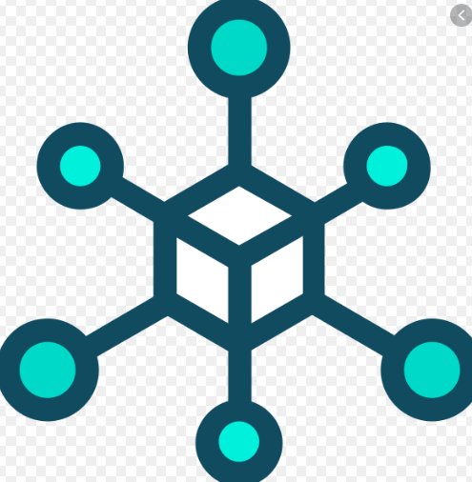

Solution Roadmap : Steps Towards Envisioned Future
“As a product, if you try to become everything for everyone before you become something for someone, you end up becoming nothing for no one”
-Kunal Shah, Founder & Ex. CEO - Freecharge
Envisioned Solution Roadmap involves an Incremental Development Approach to Continuously Gauge End-User Feedback & Evolve Accordingly…
Security clearance & certification, IP Protection (as applicable), Pricing Strategy
Soft-launch of the solution within a fishing community @ Sunderban, WB
Form Support desk & User Feedback Collection
Integration with Water Quality Management toolsets (Pumps, Oxidizers etc.)
Explore collaboration with existing players in this sector & offer integration points
Include Predictive Analytics feature with AI/ML capabilities
Form Pay-Per-Usage model for Advanced offerings such as ML
Q4,2020
Q1,2021
Q2,2021
Q3,2021
Q4,2021
Q1,2022
Include IoT sensors for Salinity, Oxygen level & pH Tracking
Completion of outstanding design/development work in Mobile App & Web Portal
Additional sensors on-demand
UX Changes in Mobile/Web App in line with User Feedback
Improved Locale language support
Improved support in additional Mobile devices and browsers
Establish integration with Govt. channels such as BDO office etc.
Chat-bot support & Fishermen groups

Slide 7
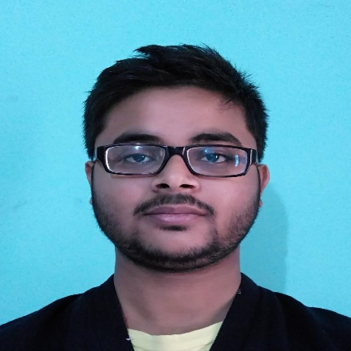
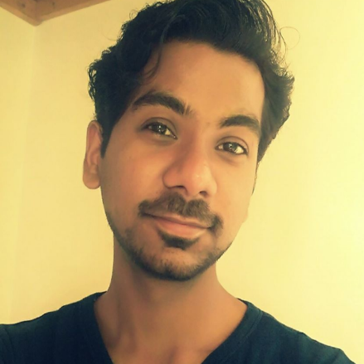
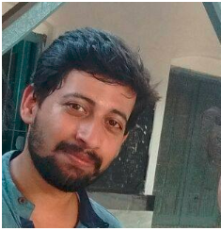
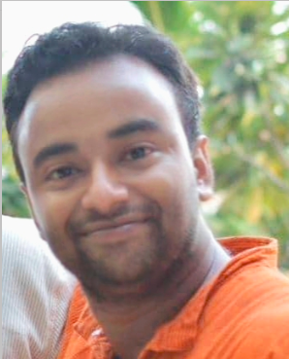
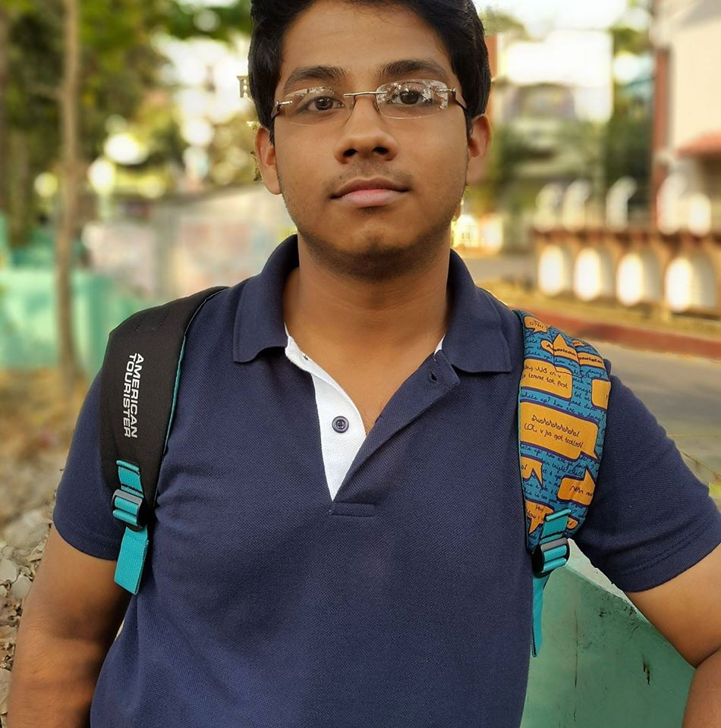
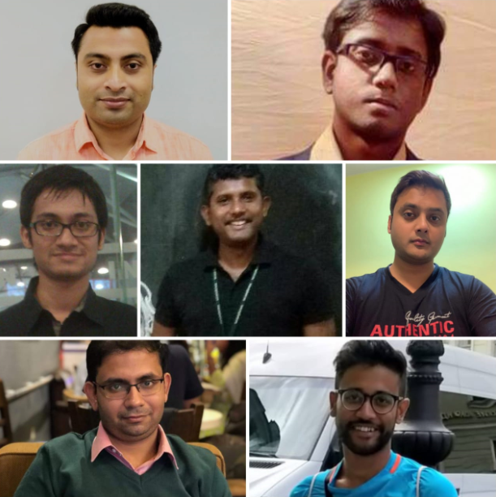

Solution Prototyping Team : Faces Behind the Solution
ZERO Cost of Implementation with Self-Motivated Effort from Associates as part of Cognizant vision and mission statement on Social Responsibilities – Existing QE Upskilled Delivery Team formed a POD for 1 Month to Design, Code and Deliver the solution following Agile principles
Aditya Nandy,
IoT & Micro-processor Expert
Sachin Rajan,
Mobility Engineer, UX Designer
Soumyajit Datta,
Cloud Specialist, Backend Designer
Suman Chanda,
Technical Lead, Scrum Master, Domain Expert
Soham Roy,
Web Developer, QA Lead
Atip Roy,
Solution Architect,
Micro-services Engineer
Important Links & References:
Github Repository: https://github.com/GangOf7
Demo Video @ Youtube: <<Link to be added >>

Slide 8
THANK YOU

